Slide 1
Learning to cooperate or “How I became a good neighbor”
Milos Rovcanin
IBCN reasearch group, INTEC, UGhent

Slide 2
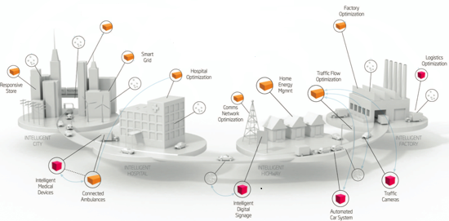
Status quo
Enormous increase of the density of co-located, multi-purpose networks.

Slide 3
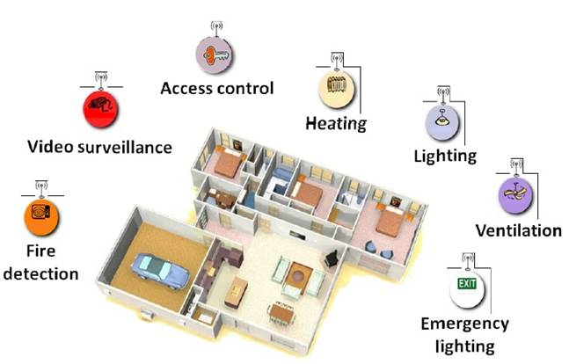
Zooming in
A typical household will (is) be equipped with a number of
wireless networks, for all sorts of purposes: controlling temperature,
access to premises, temperature, ventilation etc.

Slide 4
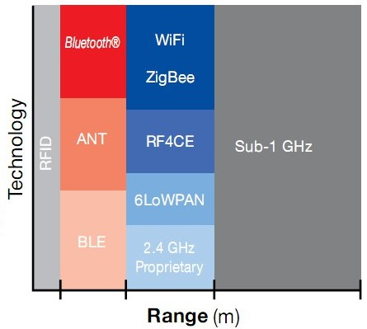
Network diversity
A huge variety of network preferences and their hardware/software capabilities:
Wifi standards IEEE 802.11a, 802.11b, 802.11g and 802.11n (at 2.4 GHz)
Zigbee standard IEEE 802.15.4 (at 2.4 GHz)
6LoWPAN (RFC 4944) standard IEEE 802.15.4 (at 2.4 GHz)
ONE-NET is an open-source standard for designed for low-cost, low-power control networks
Bluetooth standard 802.15.1 (2.4 up to 2.8 GHz)
Bluetooth Low Energy (Wibree) is a subset to Bluetooth V4.0 with an entirely new protocol stack for rapid build-up of simple links.
ANT: ANT is a proprietary wireless sensor network technology operating at 2.4 GHz that provides a low-cost and ultra-low power solution for short-range wireless communication in point-to-point and more complex network topologies
Source: Texas Instruments Wireless Connectivity

Slide 5
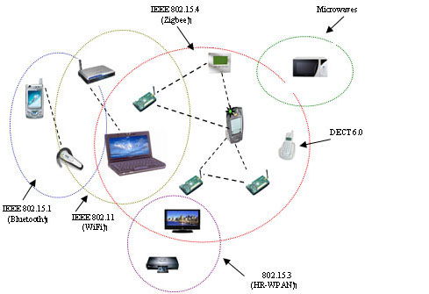
Sharing a common radio frequency
Communication interference is commonplace:
Interference avoidance as a basic form of inter-network cooperation

Slide 6
A preliminary conclusion
Static grouping of mobile devices is complex, inefficient and might lead to a waste of resources
Network solutions that dynamically support at run-time cooperation between devices from different types of networks are becoming a necessity.

Slide 7
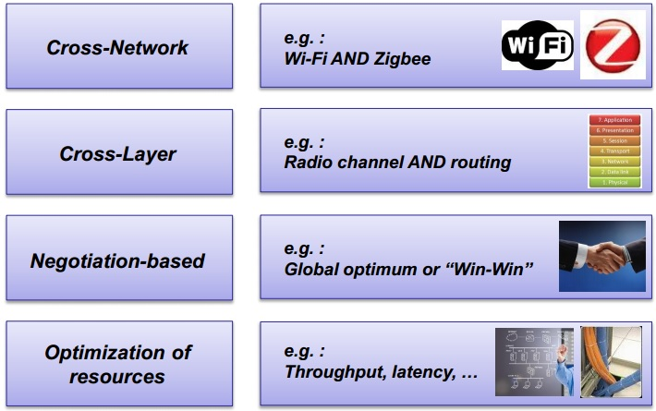
Incentive driven networking
A cross-layer, cross-network negotiation methodology for optimizing network resources

Slide 8
Incentive driven networking
Incentive describes a high-level network behavior or a reason for cooperation:
Describe behavioral aspects of the network
Express the need for additional functionality
Give an indication of the expected performance network metric
Examples:
High throughput, high reliability, low delay (better QoS)
High network lifetime
High coverage
Low exposure
Public access

Slide 9
Network services
Whereas incentives indicate network goals, network services are means to realize these goals
Network services should be understood as optimization techniques that have influence over one or more incentives
Examples:
packet aggregation and sharing, MAC protocols, interference avoidance techniques …

Slide 10
Network services
Activating network services has (positive or negative) influence not only in a network where the service is activated.
By carefully choosing which service to activate, networks can improve not only their own, but the neighboring network’s performance as well.

Slide 11
The major issue
How to efficiently determine the optimal configuration parameters for all the participating networks, considering their high level goals and ensuring that the cooperation in mutually beneficial?

Slide 12
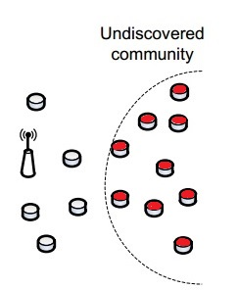
Incentive driven networking
Step 1:
Devices dynamically search for co-located devices with similar network preferences and hardware and/or software capabilities

Slide 13
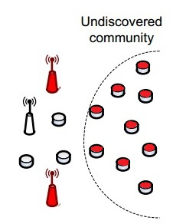
Incentive driven networking
Step 2:
If such devices are found, communities consisting of interconnected objects with similar network expectations are formed on an ad hoc basis

Slide 14
Incentive driven networking
Step 3:
Different communities will now able to cooperate with each other by activating and sharing (software or hardware) network resources.

Slide 15
A self learning decision maker
There is a need for a reasoning entity that will initiate and control the cooperation process.
It will use certain performance metrics to make an assessment of every relevant and utilized service combination, over an entire symbiotic network.
It must be able to automatically reconfigure all the participating networks, depending on a decision it makes.

Slide 16
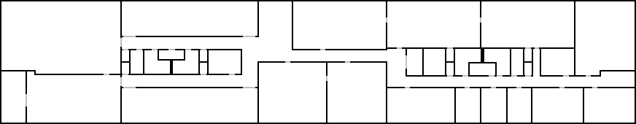
A self learning approach – use case
Final goal: three-tiered learning paradigm
Tier 1: Optimization of service settings (in-layer)
Tier 2: Selection of optimal service sets (cross-layer)
Tier 3: Cross-network negotiation (cross-network)
Also take into account the requirements of co-located networks
The goal:
Determine the best combinations of network services
B
A
B
A
B
B
A
B
A
B
A
A
A
B
A
Sink B
B
A
B
Sink A
A
Temperature sensor node (community A)
B
Intrusion detection sensor node (community B)

Slide 17
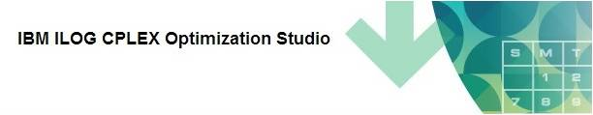
The initial approach
Linear programming (LP)
Negotiation entity (NE) collects network’s service profiles and “calculates” the optimal service set for every sub-net using an IBM’s linear programming engine

Slide 18
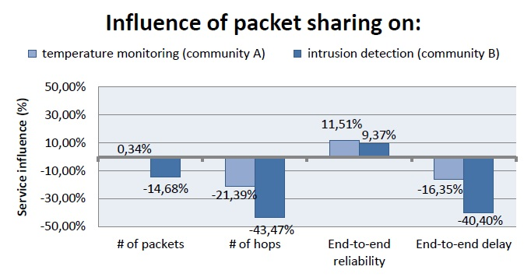
Disadvantages
Requires a priori knowledge - fixed benefits and costs for activating each service:
Eli de Poorter, Pieter Becue, Milos Rovcanin, ingrid Moerman, Piet Demeester, “A negotiation-based networking methodology to enable cooperation across heterogeneous co-located networks”

Slide 19
Disadvantages
Information about the service influences is extremely difficult to obtain:
Simulation
From a literature
Assumed …
Most of this data relates to static networking cases and change drastically when some of the network parameters change.
Conclusion:
ILP solver is a poor solution for dynamic environments

Slide 20
Possible alternatives
More adaptable to environments with fast changing parameters and much less demanding when it comes to a priory input information
Simulators
Mathematical modeling
Game theory
Machine – reinforcement learning

Slide 21
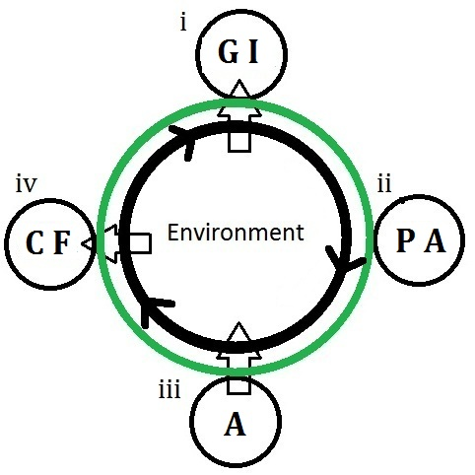
Cognition cycle
4-steps:
Gathering Information (GI)
Planning Actions (PA)
Act (A)
Collecting Feedback

Slide 22

Reinforcement learning
Modeled as a Markov decision process (MDP)
A decision maker goes through states: S = {S1, S2, … , S3}
Taking one of the available actions A = {a1, a2,… aN} at each step
The Bellman equation describes the learning process:
At each step, take the action that will maximize Q-value for the given state/action pair

Slide 23



Reinforcement learning
Bellman equation:
Immediate reward
expected future reward
state transition probability

Slide 24
The major issue
An MDP model differs from case to case. In most of them, it is not known a priory
A universal method for solving these kind of optimization problems has to be model-free

Slide 25

Least Squares Policy Iteration - LSPI
First Introduced in:
M. Lagoudakis and R. Parr. “Model-free least-squares policy iteration”. In Proc. of NIPS, 2001.
Instead of relying on a pre-learned MDP model, an agent collects process samples
One set can be used for different policies
Additional samples can be added, during the learning process, to an existing set

Slide 26


Least Squares Policy Iteration - LSPI
Approximates Q-function with its linear represent:
- basis functions represent a network’s feature (e.g., residual energy of s’, link quality between s and s’ etc.)
- a corresponding weight factor

Slide 27
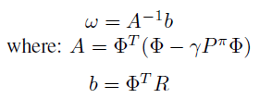
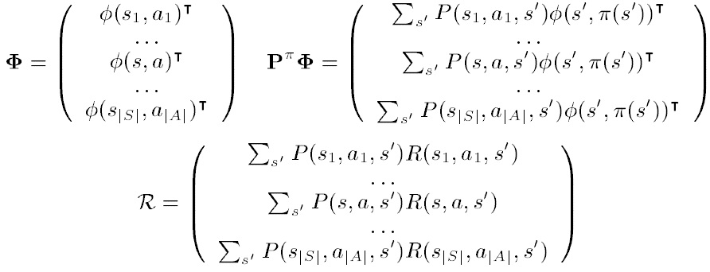
Least Squares Policy Iteration - LSPI
After combining the Bellman equation and it’s linear approximation:
And the corresponding matrices are given as:

Slide 28
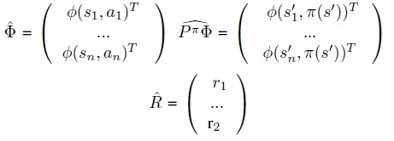
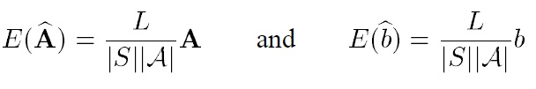
Least Squares Policy Iteration - LSPI
Approximated values for matrices:
To improve consistency between the approximated and the actual values:

Slide 29
Least Squares Policy Iteration - LSPI
LSPI - strong points:
It converges faster than all other known algorithms, since the samples are used more efficiently.
It does not require fine tuning of the initial parameters such as learning rate
LSPI learns the weights of the linear functions and updates Q-values based on the most updated information regarding the features, while in other approaches agents make decisions directly based on Q-values, which may be outdated, depending on the network dynamics.
The same set of samples is used to evaluate different policies

Slide 30
Implementation
Milos Rovcanin, Eli De Poorter, Ingrid Moerman, Piet Demeester, “A reinforcement learning based solution for cognitive network cooperation between co-located, heterogeneous wireless sensor networks”, AD HOC Networks, 17: 98-113 (2014)
Sub-net A: temperature monitoring sensor nodes
Incentives: high network lifetime
Available services: packet sharing, aggregation
Sub-net B: intrusion detection sensor nodes
Incentives: low delay, high network lifetime
Available services: packet sharing, aggregation
B
A
B
A
B
B
A
B
A
B
A
B
A
A
A
Sink B
B
A
B
Sink A
A
Temperature sensor node (community A)
B
Intrusion detection sensor node (community B)

Slide 31
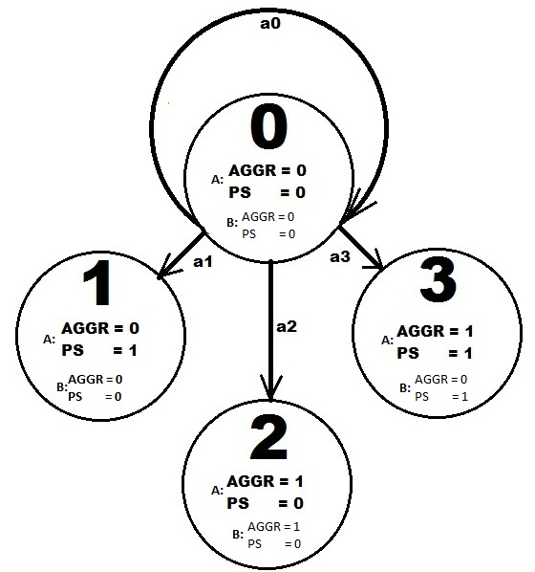
Implementation
A service combination represent a state
S = {s0,s1,s2,s3}
Activating or deactivating a service
is considered to be an action
A = {a1,a2,a3,a4}
Reuse of the existing data (CPLEX ILP Solver)
- reduced set of states and constrained actions

Slide 32
Implementation
Two phase process:
Exploration phase – Exhaustive search through the state problem space, investigating every service combination
Exploitation phase – use “Epsilon greedy” algorithm to enforce optimal decisions, while staying versatile to adapt to possible network condition changes

Slide 33
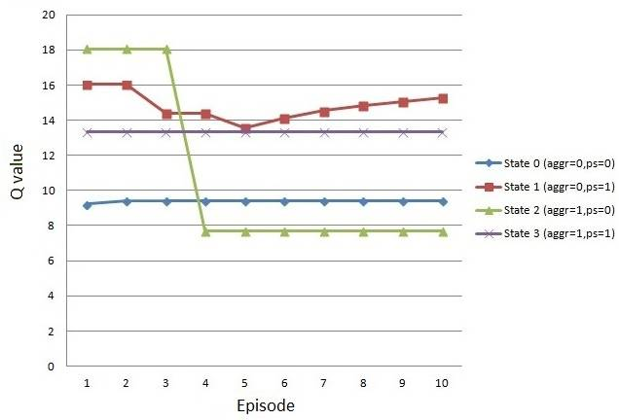
Implementation
Exploration phase:
Collect the information about
every state/action pair
Use a pseudo random walk to
collect samples
Once it is done, calculate the
initial set of weights and Q values

Slide 34
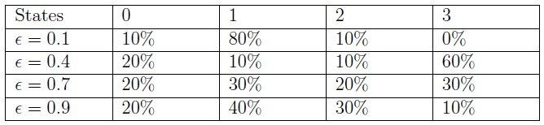
Implementation
Exploitation phase:
Percentage of the number of episodes that system have spent in each state during a particular experimental run. Each run is characterized by a different value of the “epsilon” factor = (0.9, 0.7, 0.4, 0.1).

Slide 35
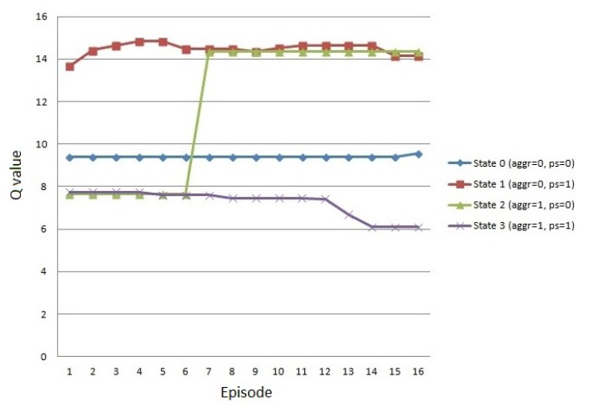
Implementation
The “worst case” scenario:
The optimal and the worst performing service combinations switch performances (not highly probable – for a demonstration purpose only)

Slide 36
Open issues
To find an optimal value for the “epsilon” factor:
forcing the optimal service combination vs. versatility to condition changes
Scalability of the algorithm:
emphasize on an exploration phase
Stopping rules

Slide 37
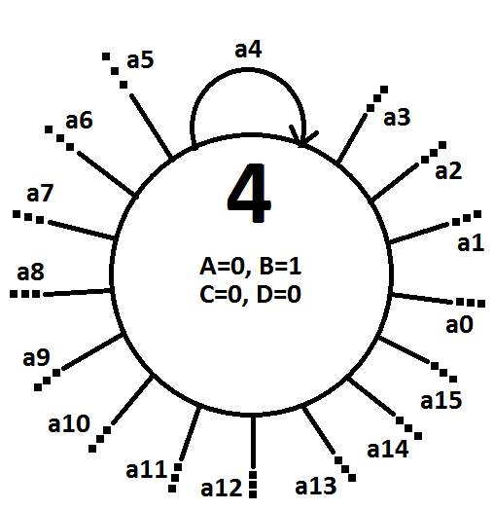
Implementation – a more complex use case
16 experimental service combinations (e.g A, CD, ABD …)
Pre-estimated influences for each combination
16 actions available at every state
One basis function per incentive – Phi1, Phi2 (e.g. end-to-end delay, average number of re-transmissions)

Slide 38
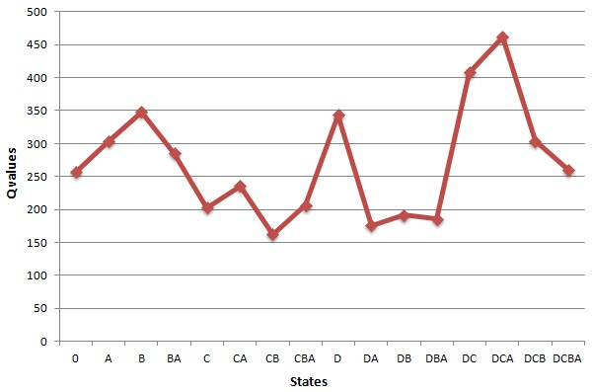
Implementation – a more complex use case
Exploration phase:
Calculate the initial set of weights (ω1, w2)
Calculate the initial set of Q values for every state/action pair

Slide 39
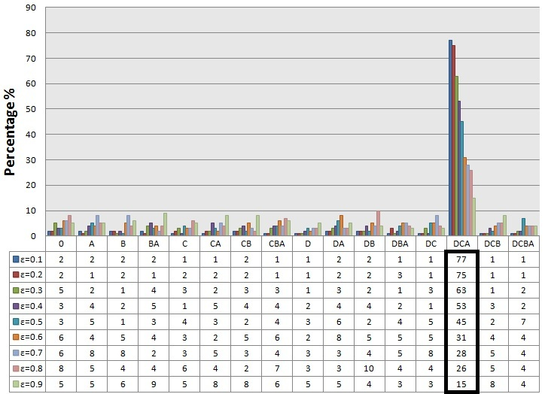
Implementation – a more complex use case
Exploitation phase (epsilon greedy)
Results after 100 learning episodes, no disturbances present:

Slide 40
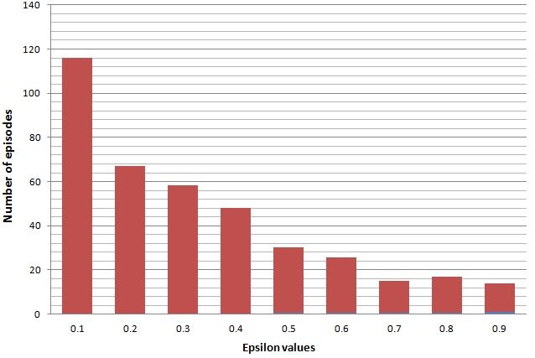
Implementation – a more complex use case
Exploitation phase:
Reaction to a network condition disturbance (worst case scenario)

Slide 41
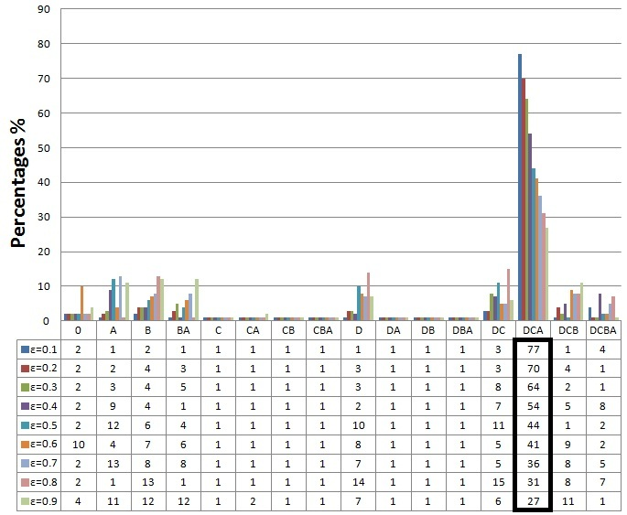
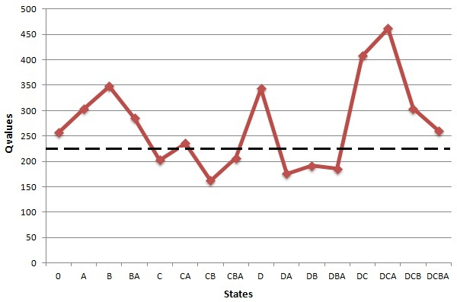
Implementation - a more complex use case
Exploitation phase:
Introducing a simple efficiency-improving procedure
Q value threshold:
Effects:
No significant difference in the number of episodes spent in the optimal state
Significant reduction in the number of episodes spent in the worst performing states

Slide 42
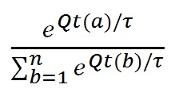
Implementation – introducing SOFTMAX
SOFTMAX exploiting strategy:
Probability of choosing a service combination depends on it’s Q value.
τ is a positive parameter called the temperature. Low temperatures cause a greater difference in selection probability for actions that differ in their value estimates.

Slide 43
Implementation – real life measurements
Exploring 32 different states
Real life measurements
Sub-net A: temperature monitoring sensor nodes
Incentives: high network lifetime
Available services: packet sharing, aggregation
Sub-net B: temperature sensor nodes
Incentives: low delay, high network lifetime
Available services: packet sharing, aggregation
B
A
B
A
B
B
A
B
A
B
A
B
A
A
A
Sink B
B
A
B
Sink A
A
Temperature sensor node (community A)
B
Intrusion detection sensor node (community B)

Slide 44
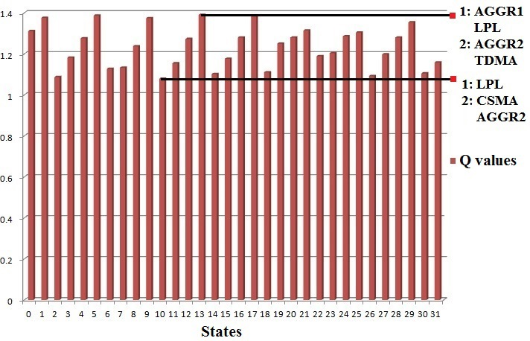
Implementation – real life measurements
Exploration phase results:

Slide 45
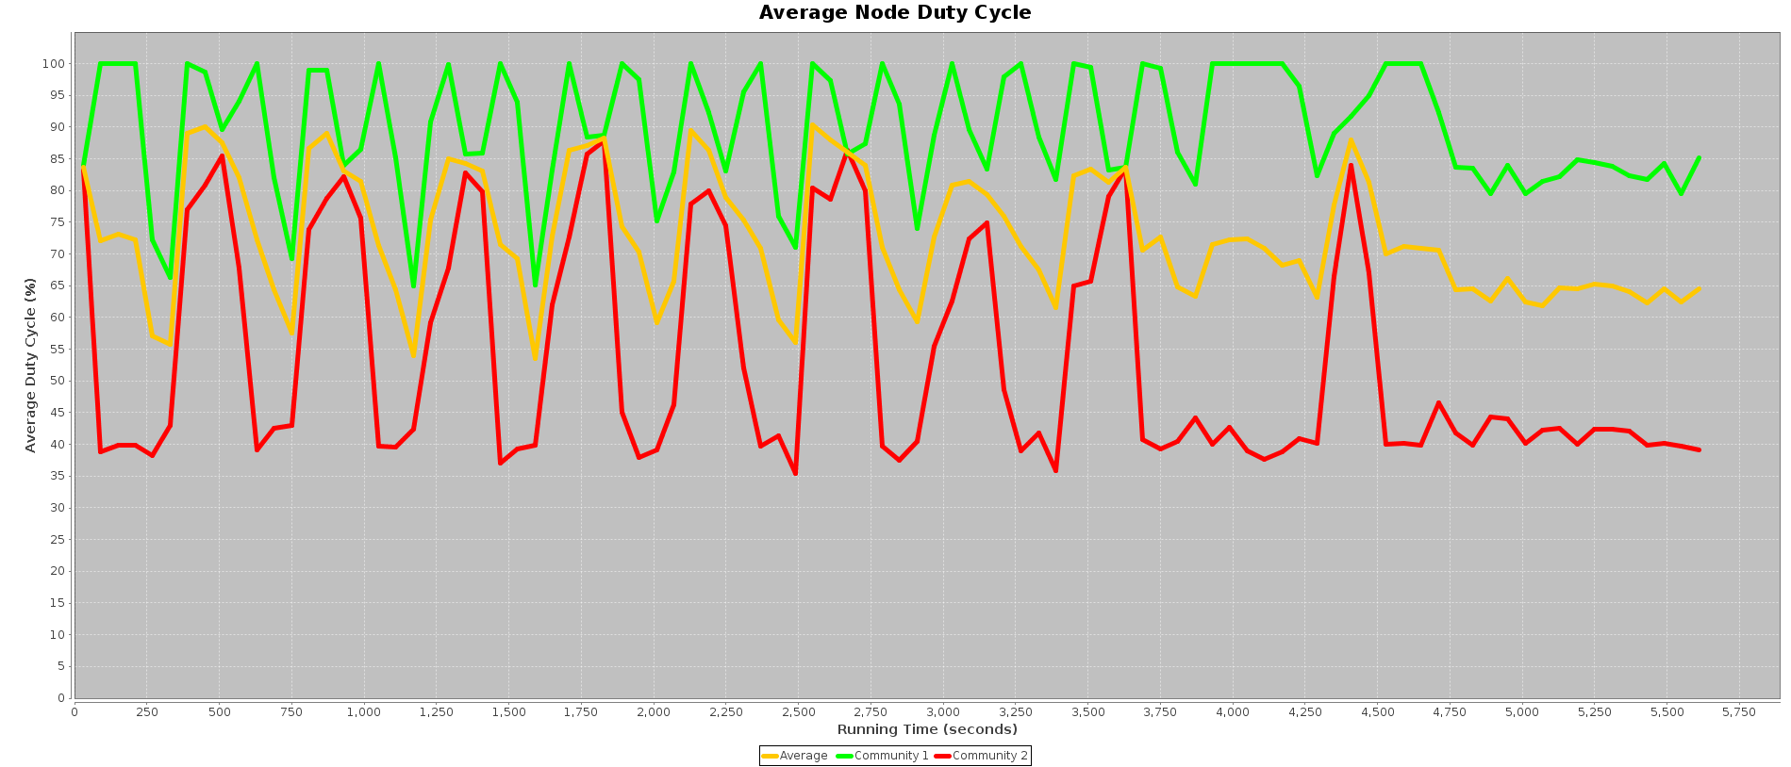
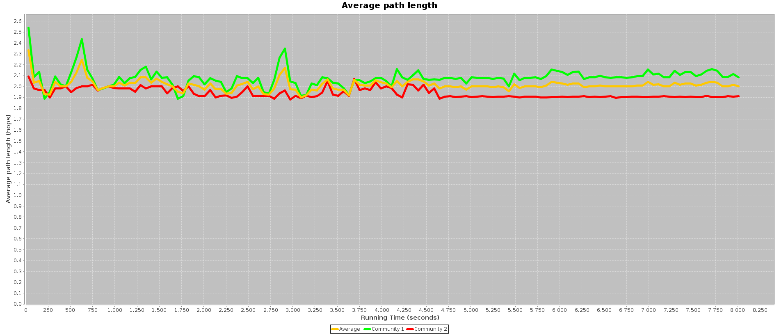
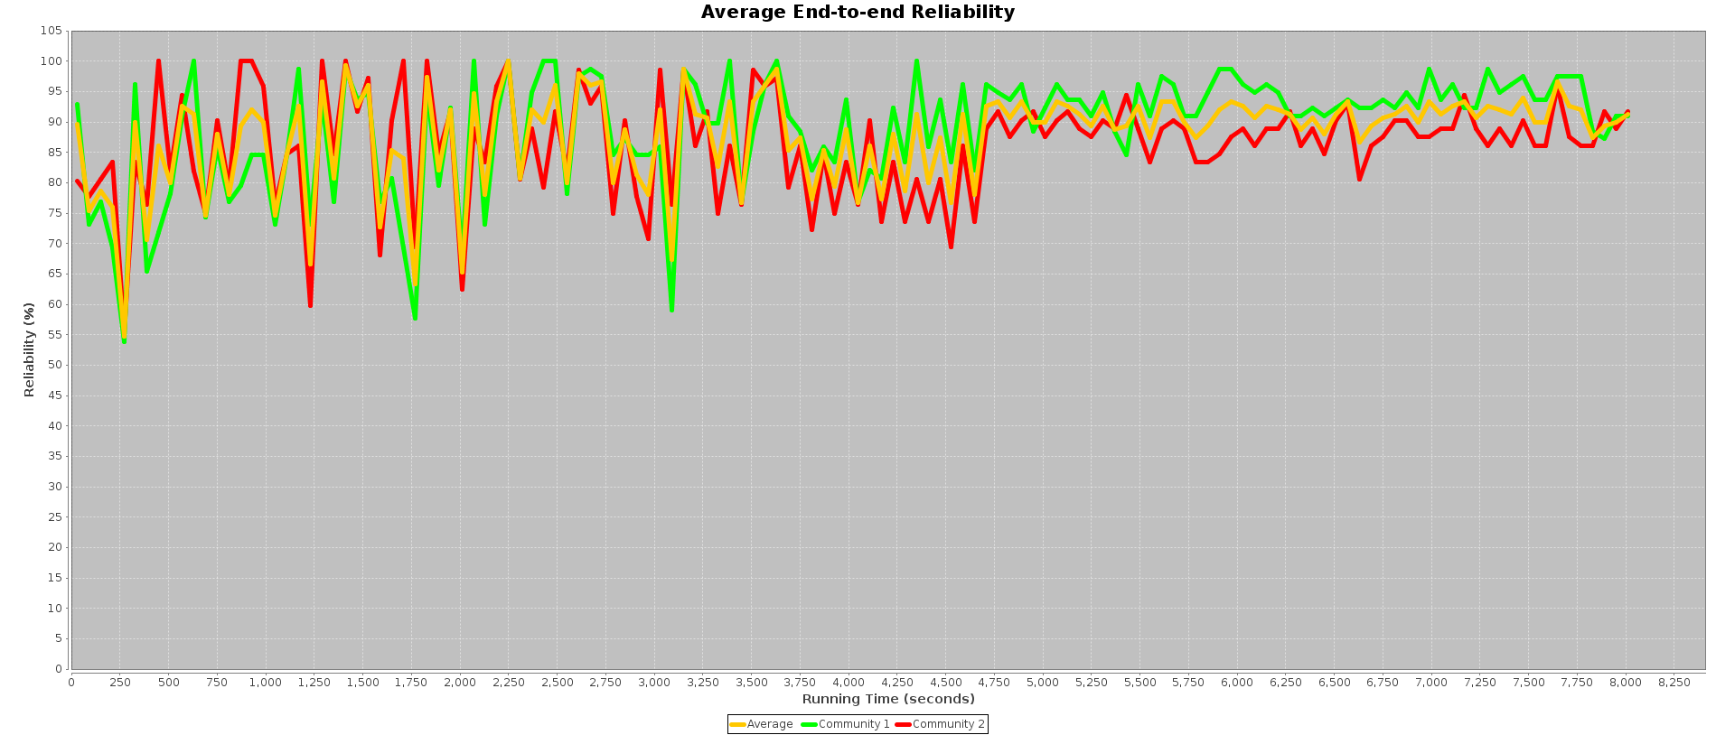
Implementation – real life measurements
Exploration phase results - steady network conditions:

Slide 46
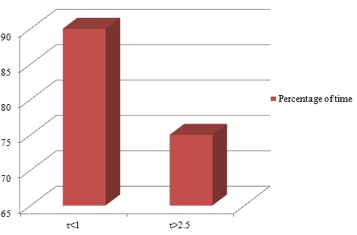
Implementation – real life measurements
Steady network conditions:
For the temperature factor values < 1, SOFTMAX enforces the optimal service combination for over than 90% of time
For comparison, for values higher than 2.5, the percentage drops below 75%

Slide 47
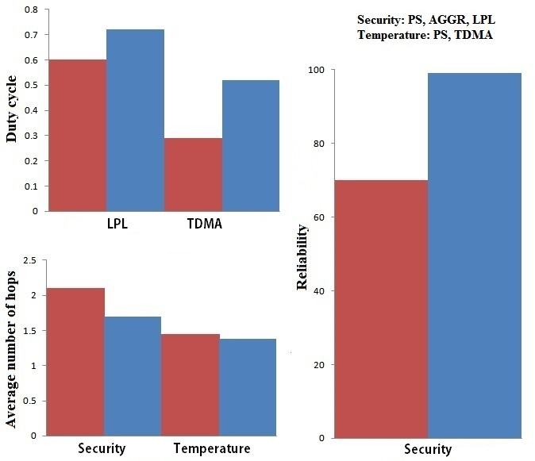
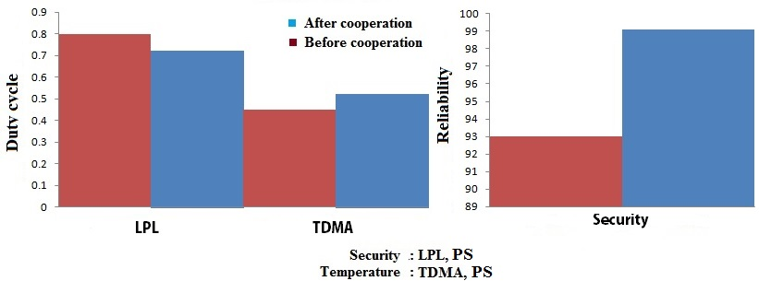
Implementation – real life measurements
A performance summary for both networks, in a single hop and multi-hop use cases

Slide 48
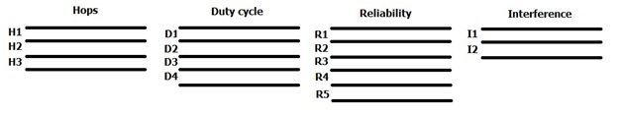

Implementation – the newest idea
Values of each of the relevant network properties will be divided into a certain number of intervals:
Every possible combination of the intervals will represent a network state. The maximum number of states can be calculated as:

Slide 49
Implementation – the newest idea
The simplest interpretation of the property intervals could be as: bad, acceptable, good. Additional intervals will ensure a finer differentiation between states. However, this will result in the higher number of them and, consequently, a longer learning period.
Interference is also included as a part of a state, which changes voluntarily. The level of interference is assessed before taking an action. If the measured interference level between the two states is different, the corresponding transition is not given a Q value. Learning processes are separated.

Slide 50
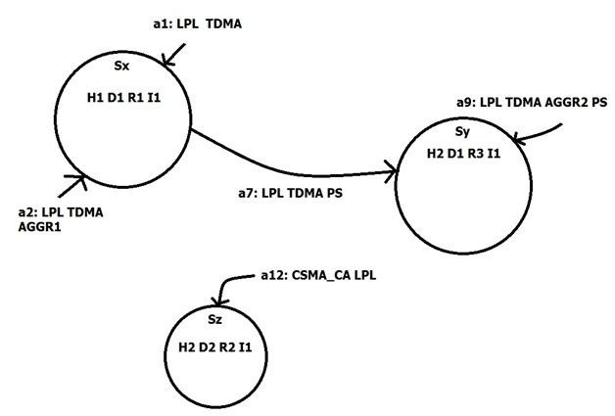
Implementation – the newest idea
Action is represented as an activation or deactivation of exclusively one service at a time:
An action is denominated not by the sole service that is changed, but by service combination it resulted in.

Slide 51
Implementation – the newest idea
Every service combination will, eventually, be associated with a certain state, meaning that taking a certain action at no matter what state, will result in a transfer to one particular state.
This can be interpreted in the following way: once a service combination – an action Ax– is activated, Q values for every (S,a) pair that includes Ax -> (S, Ax) will be updated.

